Slide 1
Browser-Based 3D Pose Estimation
CS 585 Final Project Aaron Heuckroth Elena Quijano 12/8/2015

Slide 2
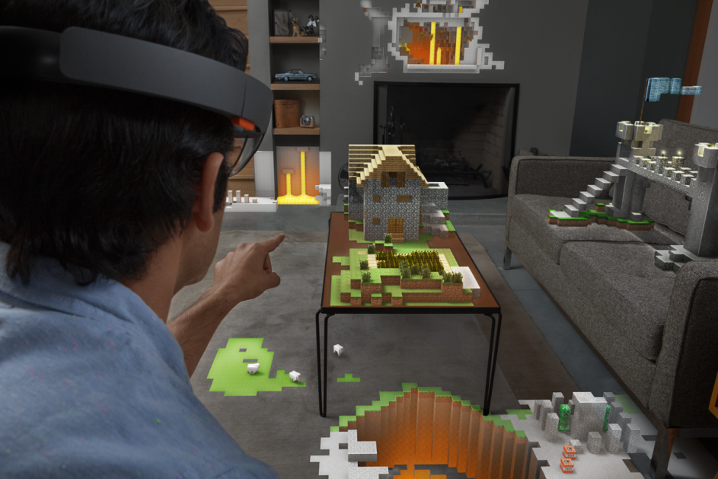
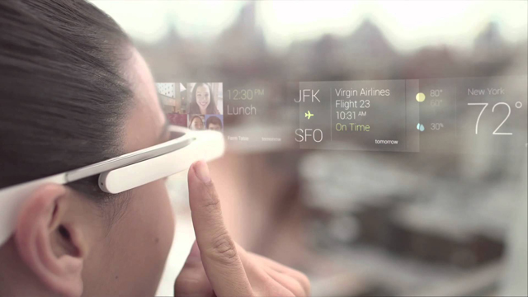
Background
Augmented Reality:
alters a user's perceptions of the physical world around them using computer-generated sensory information
Emerging tech: Microsoft Hololens, Google Glass
Concept: overlay synthetic visuals, which are intended to appear as if they exist in the 3D world, on the user's vision
An AR application must:
Gather information about the world around the user
Determine the correct position and orientation of the virtual object to be displayed
Generate the desired visuals
Overlay the generated visuals onto the user's vision (image, video)

Slide 3
Background
Pose Estimation: the method of processing a 2D object and computing its spatial properties in 3D
POSIT: Pose from Orthography and Scaling with Iterations
Requires a minimum of 4 noncoplanar image point coordinates
Determine model point coordinates (assumes the model of the object is known) that correspond to image point coordinates.
The effective focal length of the camera must also be known.
Compute rotation and translation matrices
1. 3D Pose Estimation. https://en.wikipedia.org/wiki/3D_pose_estimation

Slide 4
Project Overview
Goal: create a system that will render a 3D object onto a flat surface in a 2D image such that it appears to exist in physical space
Implement 3D pose estimation using standardized augmented reality markers in a web browser
Allow for visualization of 'holographic' models in physical space, projected into a live video stream
Respond intuitively to changes in marker or camera location and orientation and loss of tracking
Allow users to specify any 3D model (.stl file) to be rendered

Slide 5
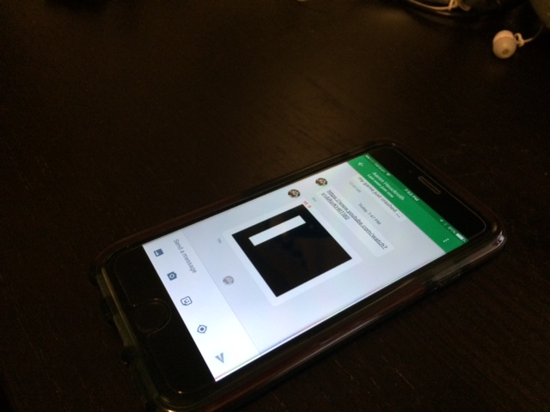
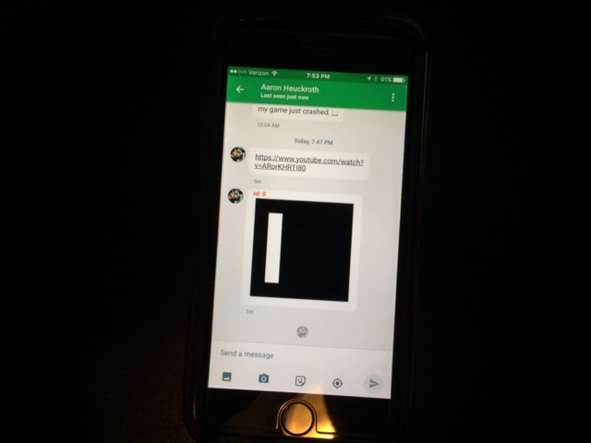
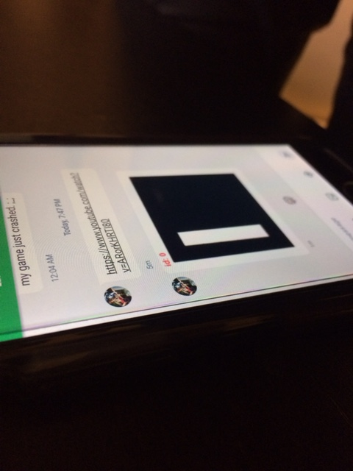
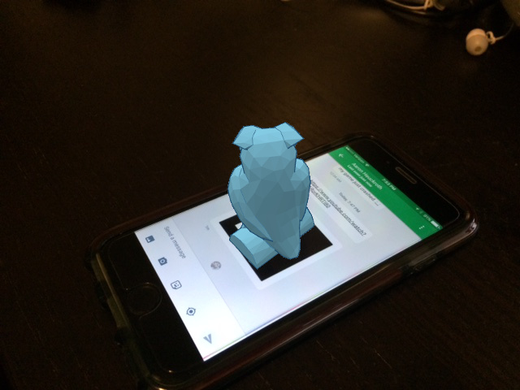
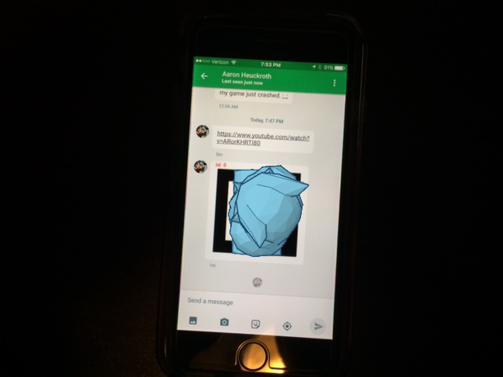
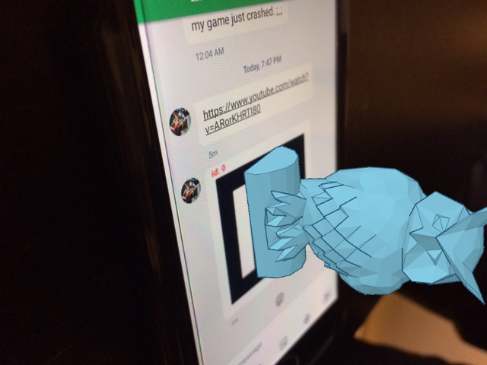
Expected Results

Slide 6
Methodology
Implement the system using Javascript
run the solution in any modern web browser
no need to compile or install additional software or libraries
Webcam feed is obtained from the browser, and individual frames are passed along to the renderer and marker detector for processing.
Markers are detected:
find black squares in the image by searching for corners
use POSIT to compute the 3D position and orientation of those markers relative to the camera.
use a downsampled, low-resolution version of the incoming webcam footage to reduce processing time and memory usage.

Slide 7
Methodology
If multiple markers are detected, we average their positions and rotations to improve our pose estimate.
The velocity for each of the 6 parameters (x,y,z location and rotation) is computed relative to the previous frame.
The 12 values (x,y,z location, rotation, and computed velocities) are passed through a Kalman Filter to remove jitter.
The filter returns an estimate of the current position and rotation of the average marker position.
The holographic model's position and rotation are updated based on the estimated position.
The model is rendered overtop of the original (high-resolution) webcam footage and displayed to the user.

Slide 8
Javascript Libraries
js-aruco: support for detecting and processing standardized AR markers.
three.js: WebGL 3D rendering library, allows us to render 3D objects directly onto images in the browser
kalman.js: 12-parameter Kalman filter
sylvester.js: Matrix math library, required to support kalman.js
STL Viewer: Used for loading arbitrary STL files.
BadTV Shader: Used to provide hologram-like distortion effects to the rendered image.
webcam.js: Provides cross-browser support for loading webcam images as standard HTML5 video.

Slide 9

Demo

Slide 10
Future Work
Project elements to improve:
Improve the filters and provide better visual feedback for which markers are in use (i.e. particles or beams extending from any currently-detected AR markers)
Implement a phone-camera based solution
Implement controls to directly adjust the size and position of the model
Experiment with a higher-resolution camera
Visualizing objects in preparation for 3D printing:
Outfit an FDM 3D Printer with one or more webcams and a set of AR markers to preview the positioning and size of objects from the 3D models used to print them.
Use the 2D projection of the 3D model to detect printing errors by comparing it against the shape of the object during printing, which could be obtained through segmentation using brightly-colored plastic filament.

Slide 11
References
3D Pose Estimation. https://en.wikipedia.org/wiki/3D_pose_estimation
js-aruco: https://github.com/jcmellado/js-aruco
three.js: http://threejs.org/
HTML5: http://www.html5rocks.com/en/tutorials/getusermedia/intro/
Kalman.js: https://github.com/itamarwe/kalman
sylvester.js: http://sylvester.jcoglan.com/
BadTV Shader: https://www.airtightinteractive.com/demos/js/badtvshader/
Webcam.js: https://github.com/jhuckaby/webcamjs
STL Viewer: https://gist.github.com/bellbind/477817982584ac8473ef/
Google Material Design Lite: http://www.getmdl.io/
POSIT: http://www.aforgenet.com/articles/posit/

